Slide 1
Department of Geography and the Alabama Museum of Natural History Learning Lab
Planning Grant Advisory Board Meeting
February 28, 2013

Slide 2
Our Grant Sponsors
Institute of Museum and Library Services (IMLS)
John D. and Catherine T. MacArthur Foundation
http://www.imls.gov/
http://www.macfound.org/

Slide 3
Youmedia.org

Slide 4
Our Team
The Alabama Museum of Natural History
Dr. Amanda Espy-Brown, Education and Outreach Coordinator
Ms. Allie Sorlie, Education Specialist
Mr. Todd Hester, Naturalist
Mr. Randy Mecredy, Director AMNH
Department of Geography
Dr. Sagy Cohen, Assistant Professor
Mr. Thomas Kallsen, Map Library Supervisor
Mr. Craig Remington, Cartographic Lab Supervisor
Linda Watson, Project Director/PI
AND YOU!!!

Slide 5
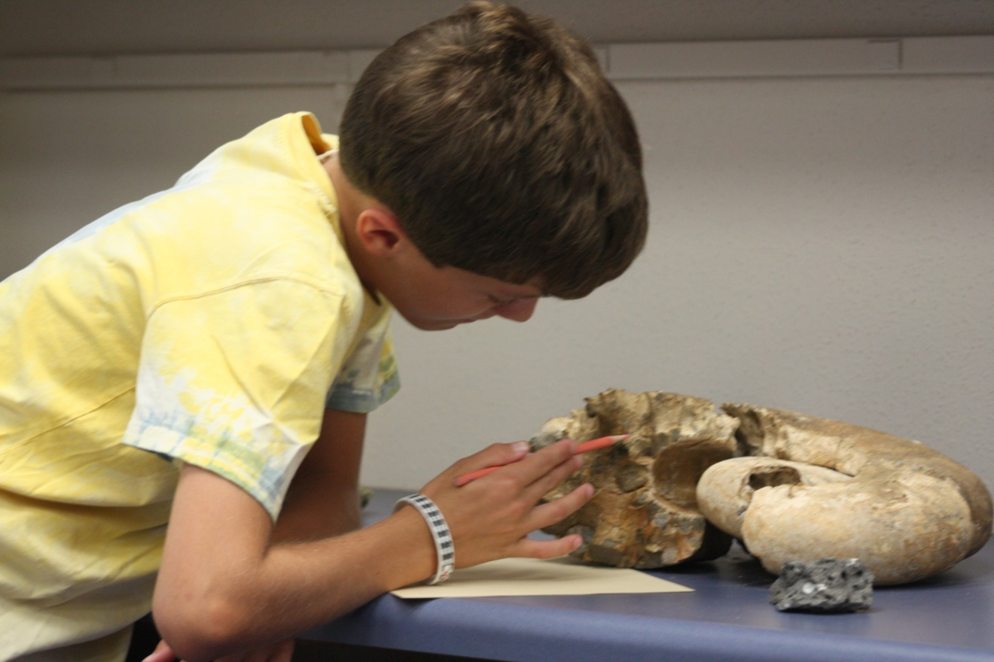
Who is our target population?
Tuscaloosa teens in the 8th through 12th grades

Slide 6
What is the purpose of the lab?
To foster connected learning
Real-world learning to help develop 21st century skills especially those necessary for careers in STEM fields
Interest driven learning designed by the teens themselves
Connecting teens to each other and to mentors via 21st century technologies in real and virtual spaces

Slide 7
The Learning Lab will be a dedicated space where teens will:
Have access to computers, iPads and GPS units
Create digital projects of their own choosing
Learn software such as Microsoft Office, Adobe Photoshop, Illustrator, and ArcGIS
Have access to peer and adult mentors
Be introduced to digital technologies in STEM disciplines by experts
inside the lab
in the field

Slide 8
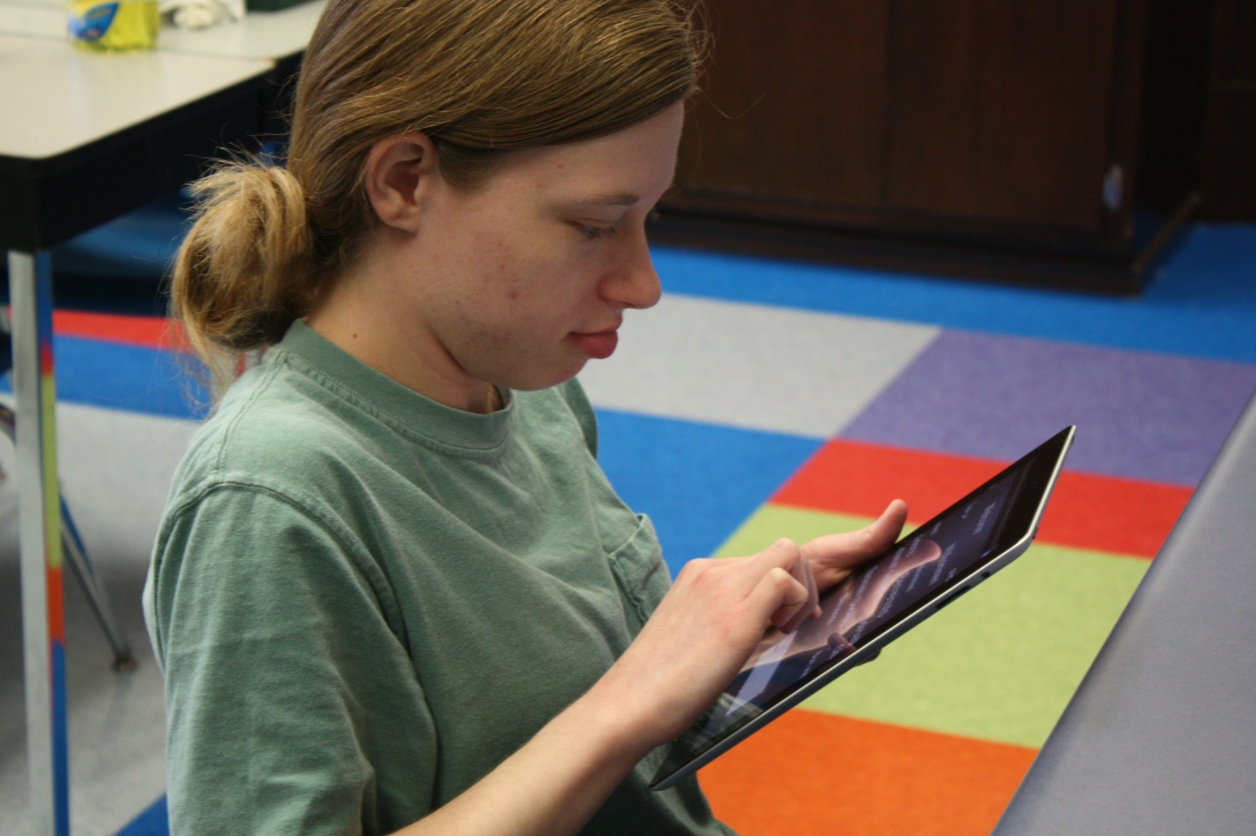
What programs will the Learning Lab offer?
After school open lab sessions monitored by staff and volunteers

Slide 9
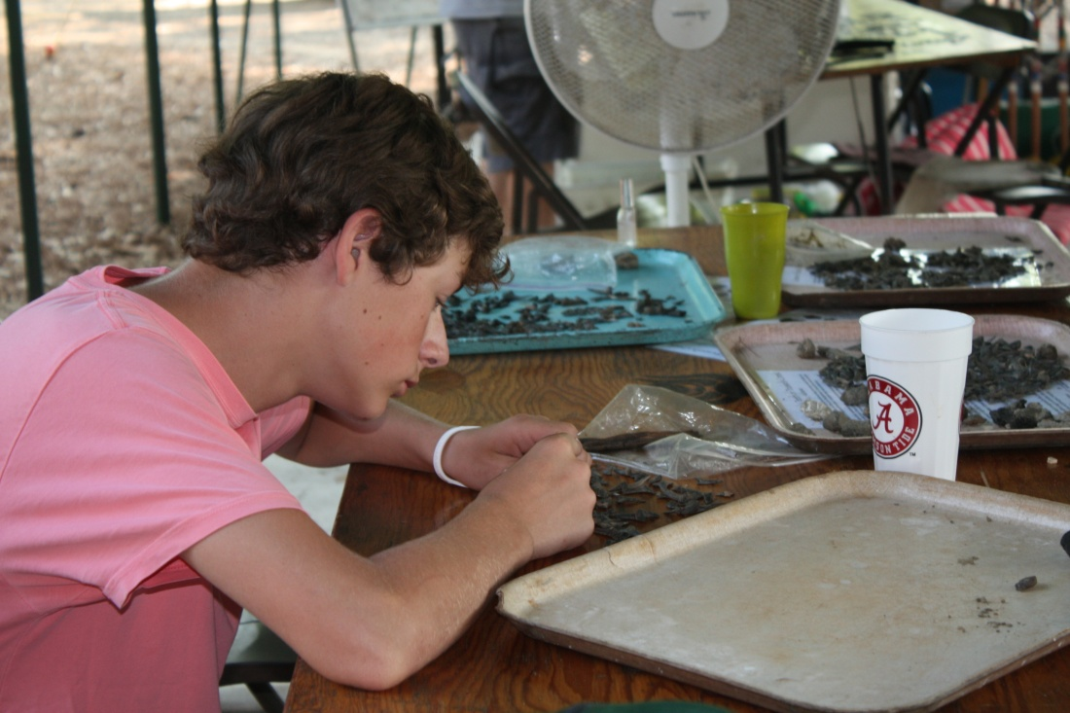
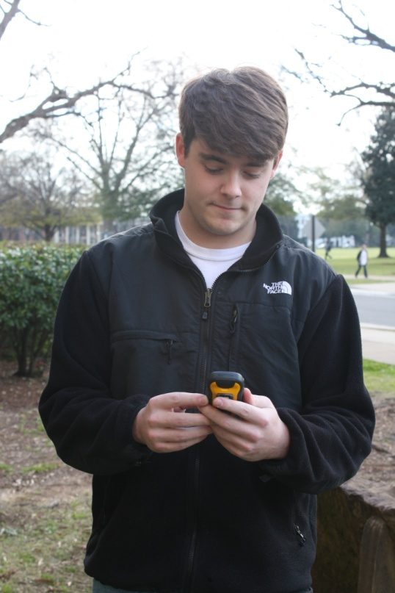
Field science programs using technologies to explore, communicate and create

Slide 10
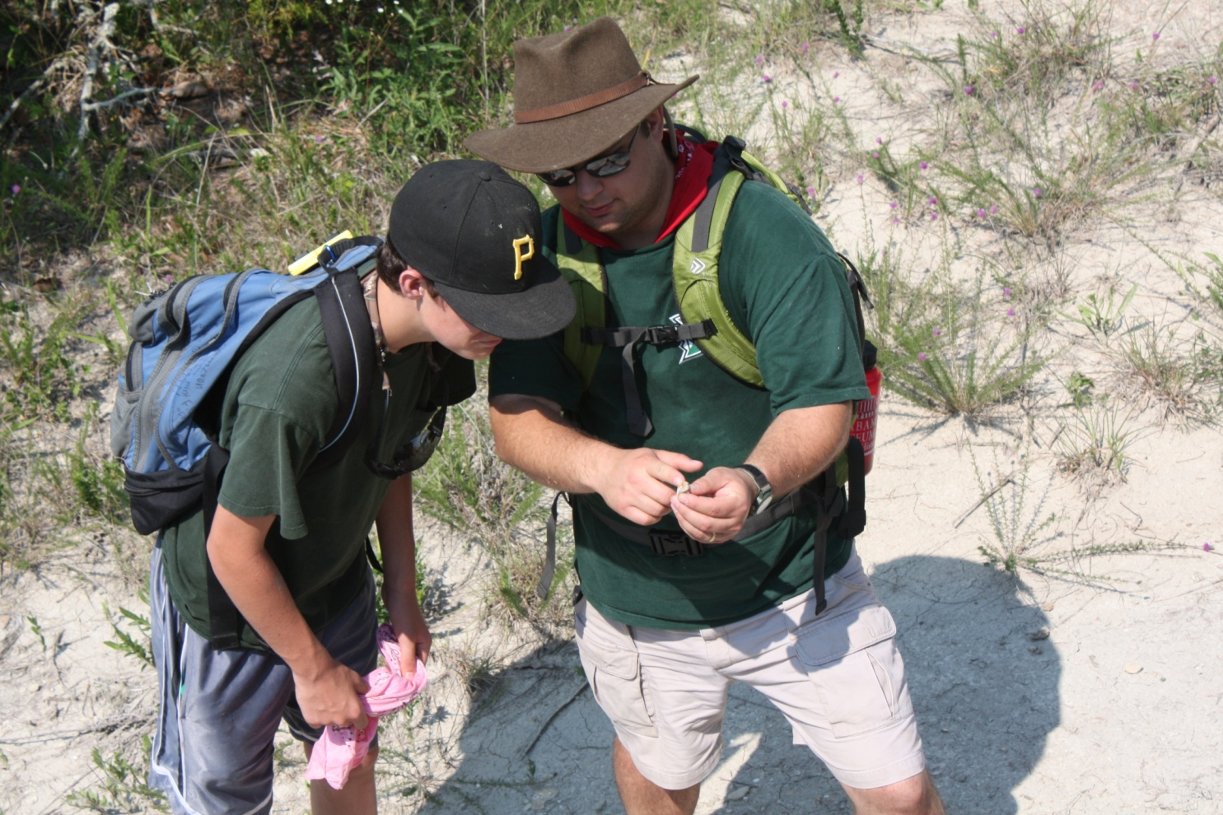
Workshops with guided instruction from trained mentors and experts from the University and community

Slide 11
Future programs which will be developed based on the feedback from the community and Teen Advisory Board

Slide 12
Our Process and Timeframe
Planning and Designing based on community needs and input January 2013- June 2014
Advisory Board (meeting every two months)
Teen Advisory Board
Opening the Learning Lab for after-school use
Targeted for April 2013
Integrating technologies into selected museum programs
Targeted for Summer 2013

